Slide 1
Intro - Lean and Kanban
Jonathan Mills
Notes:
Start Your Clicker….

Slide 2
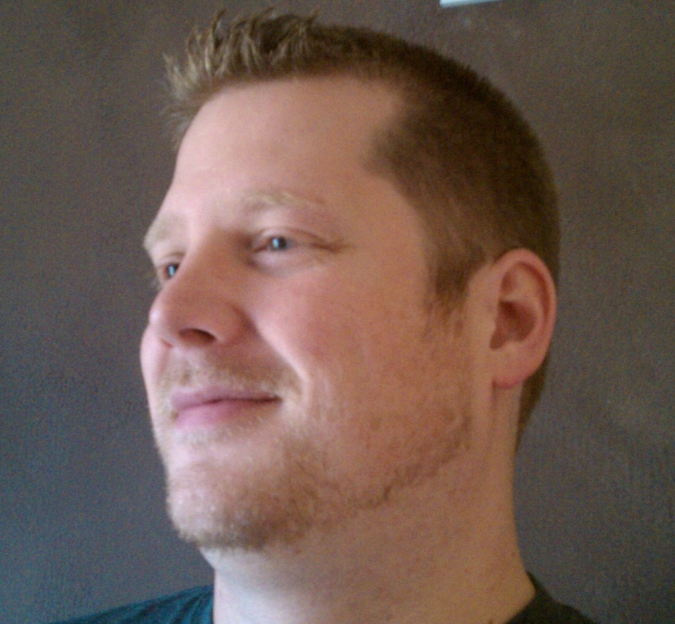
Who Is This Guy?
Practice Director / AdventureTech
@jonathanfmills
Jonathanfmills.com

Slide 3

Ground Rules
Kanban
SDLC
Dogma
Notes:
Find out who the audience is..?

Slide 4

The Problem

Slide 5
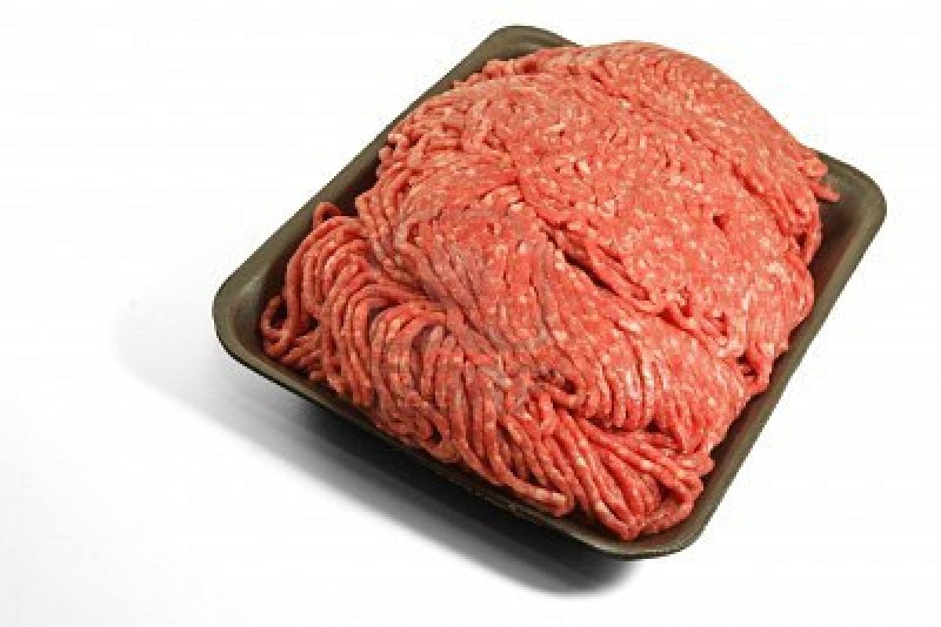
Lean?

Slide 6
Eliminate Waste

Slide 7
Amplify Learning and Understanding

Slide 8
Decide at the Last Responsible Moment

Slide 9
Deliver Fast

Slide 10
Empower

Slide 11
See The Whole

Slide 12
Lean
Think big,
act small,
fail fast;
learn rapidly

Slide 13
The Problem

Slide 14
Kanban

Slide 15
Understanding Your Process in Reality Through Visual Queues…

Slide 16


Kanban

Slide 17
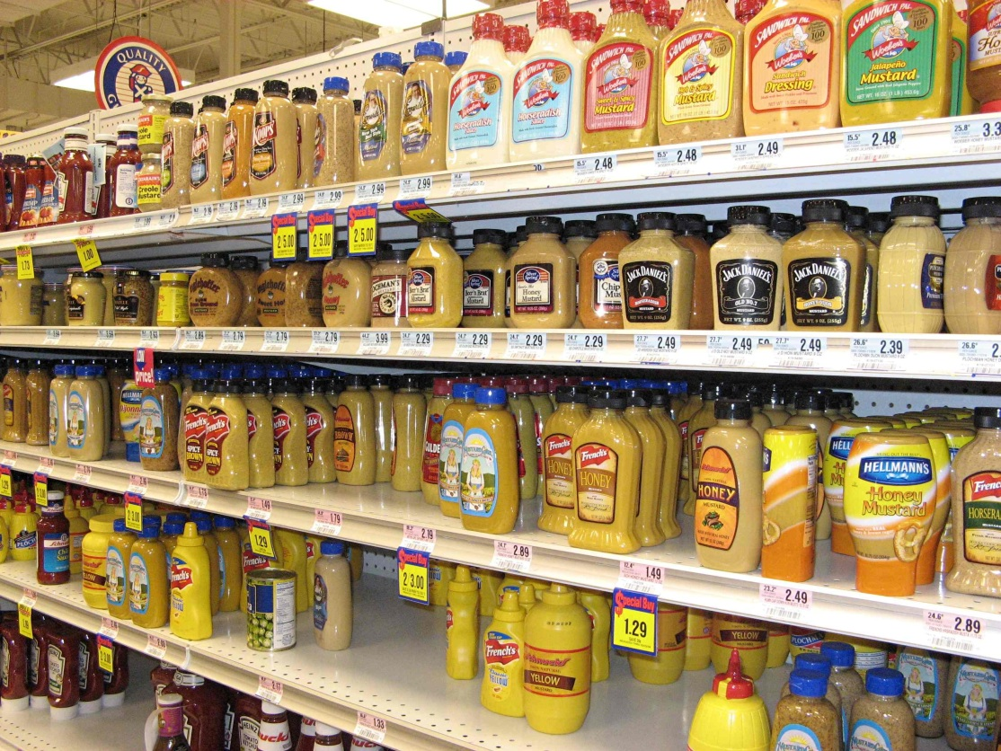

Slide 18
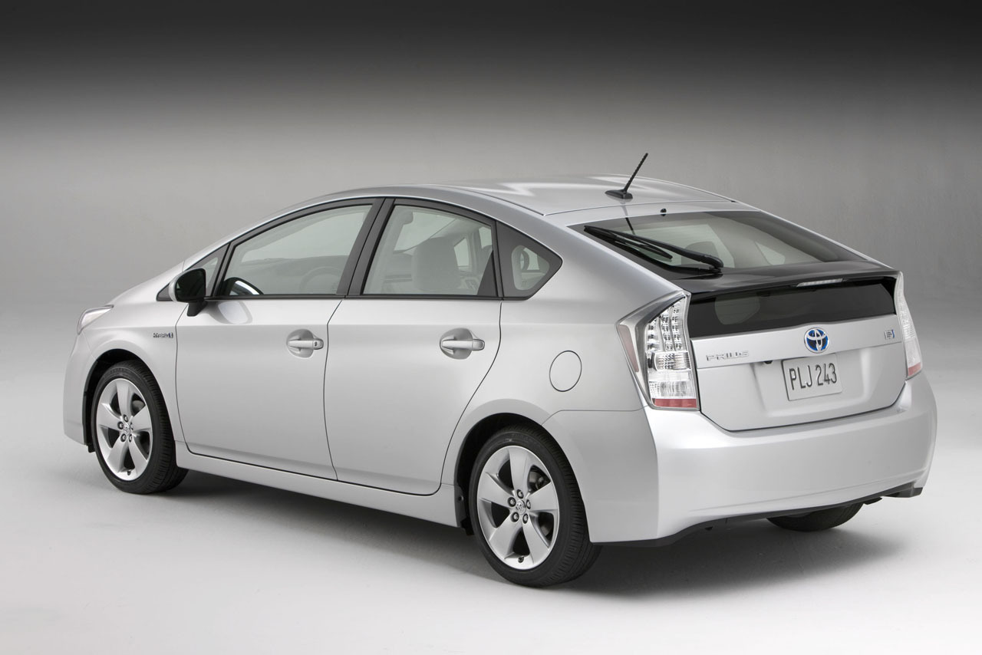
Kanban

Slide 19
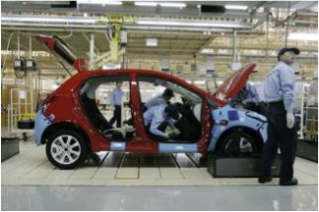
Assembling a Prius

Slide 20
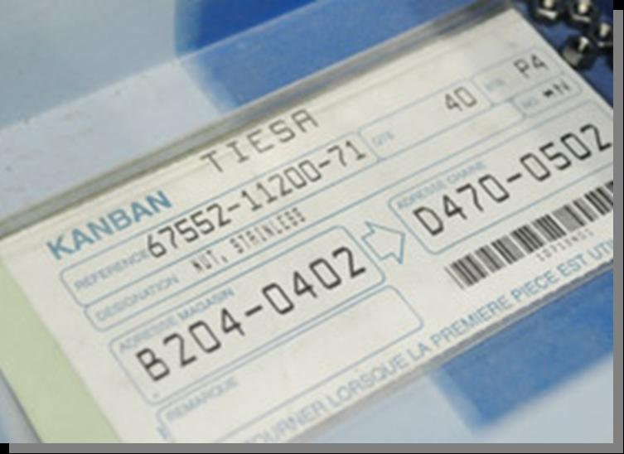
Notes:
Card = Visual Clue to do something….

Slide 21
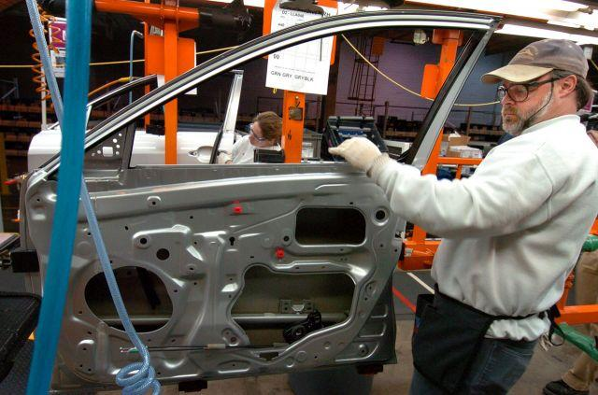

Slide 22
Kanban
Manufacturing != Software

Slide 23
The Problem

Slide 24

Kanban Principles

Slide 25
Kanban Principles
Visualize the Workflow

Slide 26
What Does It Take?
What?
How?
Do
Test
Accept
Deploy

Slide 27
What |  | How |  | Do |  | Test |  | Accept |  | Done

Slide 28
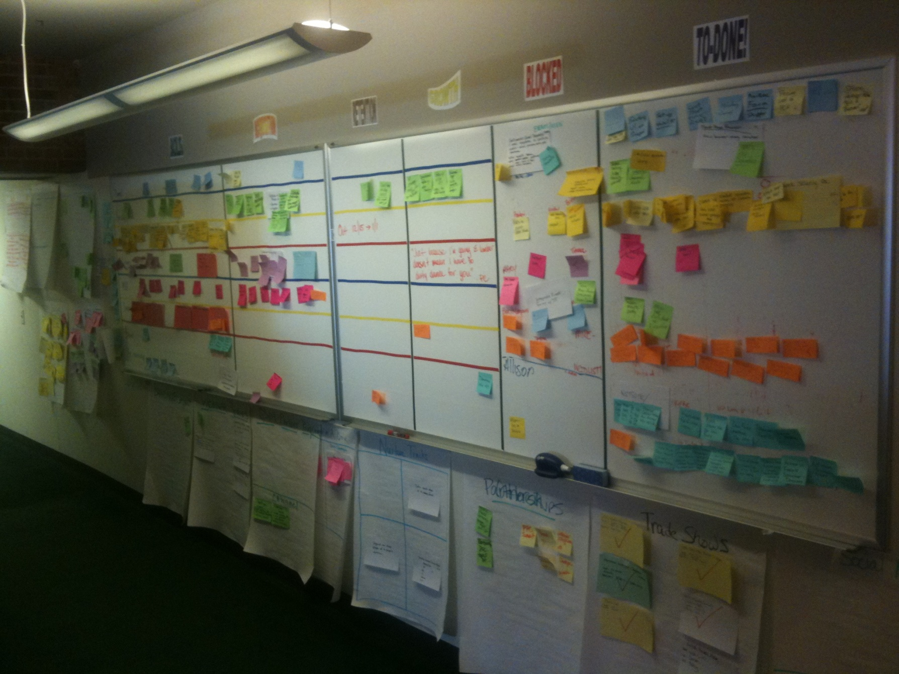

Slide 29
What |  | How |  | Do |  | Test |  | Accept |  | Done

Slide 30
What |  | How |  | Do |  | Test |  | Accept |  | Done
 |  |  |  | Not much to do. Saddness |  | New Button Jon |  | Email Notification BU |  | One thing done Sweet!
 |  |  |  |  |  | Sort Name Richard |  | Customer Portal
 |  |  |  |  |  | Get Address Jack |  | New Button Jon
 |  |  |  |  |  | New Menu Jon |  | Sort Name Richard
 |  |  |  |  |  | Cust Screen Richard |  | Get Address Jack
 |  |  |  |  |  | Cool Web Service Jack |  | New Menu Jon
 |  |  |  |  |  | Test me please… tester |  | Cust Screen Richard
 |  |  |  |  |  |  |  | Cool Web Service Jack
 |  |  |  |  |  |  |  | Why is BU not accepting?

Slide 31
Kanban Principles
Visualize the Workflow
Limit WIP

Slide 32
What |  | How(3) |  | Do (6) |  | Test (2) |  | Accept (2) |  | Done
 |  |  |  | Not much to do. Saddness |  | New Button Jon |  | Email Notification BU |  | One thing done Sweet!
 |  |  |  |  |  | Sort Name Richard |  | Customer Portal
 |  |  |  |  |  | Get Address Jack |  | New Button Jon
 |  |  |  |  |  | New Menu Jon |  | Sort Name Richard
 |  |  |  |  |  | Cust Screen Richard |  | Get Address Jack
 |  |  |  |  |  | Cool Web Service Jack |  | New Menu Jon
 |  |  |  |  |  | Test me please… tester |  | Cust Screen Richard
 |  |  |  |  |  |  |  | Cool Web Service Jack
 |  |  |  |  |  |  |  | Why is BU not accepting?

Slide 33
Kanban Principles
Visualize the Workflow
Limit WIP
Manage Flow

Slide 34
What |  | How(3) |  | Do (6) |  | Test (2) |  | Accept (2) |  | Done
 |  |  |  | Not much to do. Saddness |  | New Button Jon |  | Email Notification BU |  | One thing done Sweet!
 |  |  |  |  |  | Sort Name Richard |  | Customer Portal
 |  |  |  |  |  | Get Address Jack |  | New Button Jon
 |  |  |  |  |  | New Menu Jon |  | Sort Name Richard
 |  |  |  |  |  | Cust Screen Richard |  | Get Address Jack
 |  |  |  |  |  | Cool Web Service Jack |  | New Menu Jon
 |  |  |  |  |  | Test me please… tester |  | Cust Screen Richard
 |  |  |  |  |  |  |  | Cool Web Service Jack
 |  |  |  |  |  |  |  | Why is BU not accepting?

Slide 35
What |  | How(3) |  | Do (6) |  | Test (2) |  | Accept (2) |  | Done
 |  |  |  | Not much to do. Saddness |  | New Button Jon |  | Email Notification BU |  | One thing done Sweet!
 |  |  |  | Get Address Jack |  | Sort Name Richard |  | Customer Portal
 |  |  |  | New Menu Jon |  |  |  | New Button Jon
 |  |  |  | Cust Screen Richard |  |  |  | Sort Name Richard
 |  |  |  | Cool Web Service Jack |  |  |  | Get Address Jack
 |  |  |  | Test me please… tester |  |  |  | New Menu Jon
 |  |  |  |  |  |  |  | Cust Screen Richard
 |  |  |  |  |  |  |  | Cool Web Service Jack
 |  |  |  |  |  |  |  | Why is BU not accepting?

Slide 36
Kanban Principles
Make Policies Explicit

Slide 37
Kanban Principles
Make Policies Explicit
Improve Collaboratively

Slide 38
Kanban Principles
Improve Collaboratively
small continuous, incremental and evolutionary changes that stick

Slide 39
Great, Now What

Slide 40
The Kanban Method
Start with what you do now
Agree to pursue incremental change
Respect the current environment

Slide 41
Questions

